Slide 2
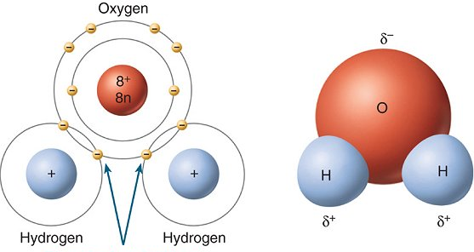
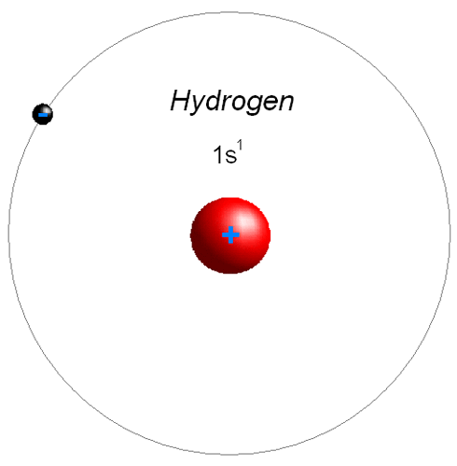
Aliphatic Organic Chemistry
CHY 211
Organic Building Blocks: Review
Lecture 1

